Slide 1
Chapter 12: Structures & Properties of Ceramics
ISSUES TO ADDRESS...
• Structures of ceramic materials:
How do they differ from those of metals?
• Point defects:
How are they different from those in metals?
• Impurities:
How are they accommodated in the lattice and how
do they affect properties?
• Mechanical Properties:
What special provisions/tests are made for ceramic
materials?

Slide 2
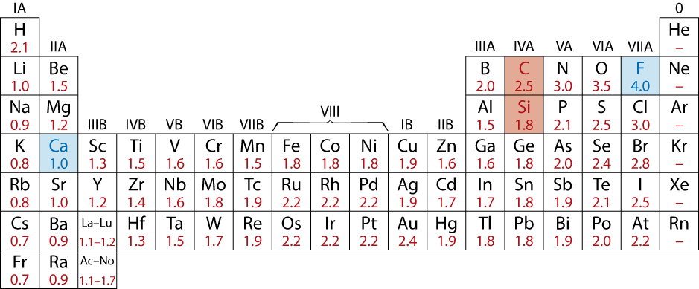
Ceramic Bonding
• Bonding:
-- Mostly ionic, some covalent.
-- % ionic character increases with difference in
electronegativity.
• Large vs small ionic bond character:
CaF₂: large
SiC: small

Slide 3
Ionic Bonding & Structure
1. Size - Stable structures:
--maximize the # of nearest oppositely charged neighbors.
-
-
-
-
-
-
+
+
+
-
-
-
-
-
-
unstable
stable
stable
• Charge Neutrality:
--Net charge in the
structure should
be zero.
--General form:
F
-
Ca
2+
CaF
2
:
+
anions
cation
F
-
A
m
X
p
m, p determined by charge neutrality

Slide 4
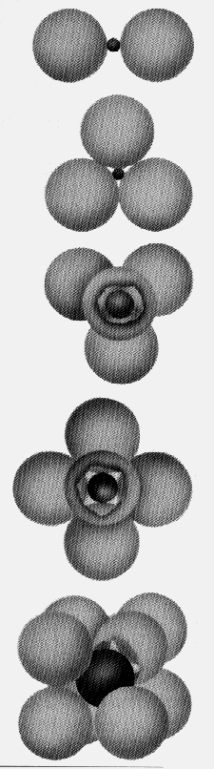
Coordination # and Ionic Radii
r
cation
• Coordination # increases with
r
anion
Issue: How many anions can you
arrange around a cation?
r
cation
Coord
#
ZnS
r
anion
(zincblende)
< 0.155
2
linear
0.155 - 0.225
3
triangular
NaCl
(sodium
0.225 - 0.414
4
T_{D}
chloride)
0.414 - 0.732
6
O_{H}
CsCl
(cesium
0.732 - 1.0
8
cubic
chloride)

Slide 5
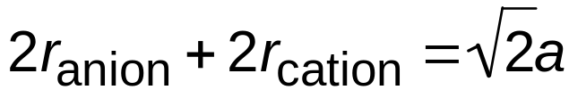
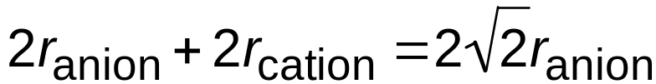
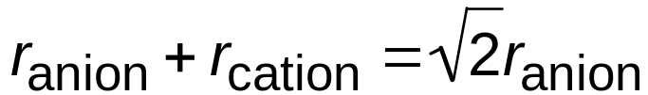
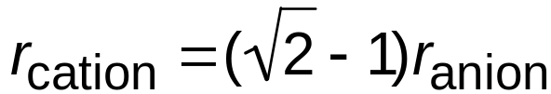
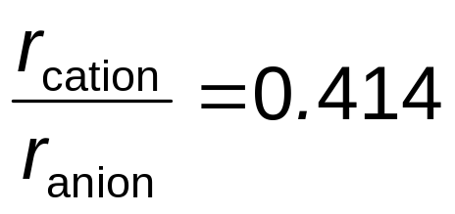
Cation Site Size
Determine minimum r_{cation}/r_{anion} for O_{H} site (C.N. = 6)
a = 2r_{anion}

Slide 6
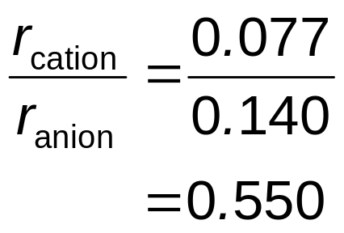
Example: Predicting Structure of FeO
• On the basis of ionic radii, what crystal structure
would you predict for FeO?
Cation
Ionic radius (nm)
• Answer:
Al
3+
0.053
Fe
2
+
0.077
Fe
3+
0.069
Ca
2+
0.100
based on this ratio,
--coord # = 6
--structure = NaCl
Anion
O
2-
0.140
Cl
-
0.181
F
-
0.133

Slide 7
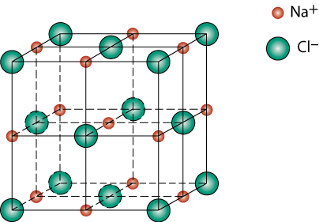
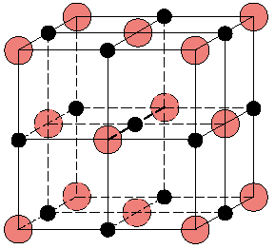
Rock Salt Structure
Same concepts can be applied to ionic solids in general.
Example: NaCl (rock salt) structure
r_{Na} = 0.102 nm
r_{Cl} = 0.181 nm
r_{Na}/r_{Cl} = 0.564
cations prefer O_{H} sites

Slide 8

MgO and FeO
MgO and FeO also have the NaCl structure
O²⁻ r_{O} = 0.140 nm
Mg²⁺ r_{Mg} = 0.072 nm
r_{Mg}/r_{O} = 0.514
cations prefer O_{H} sites
So each oxygen has 6 neighboring Mg²⁺

Slide 9
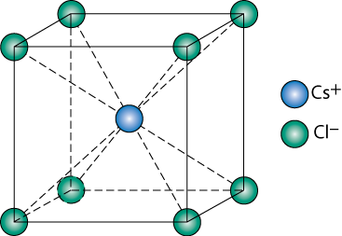
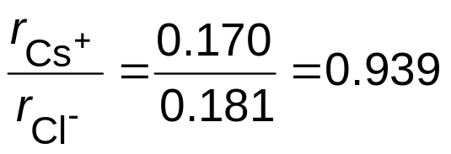
AX Crystal Structures
AX–Type Crystal Structures include NaCl, CsCl, and zinc blende
Cesium Chloride structure:
∴ cubic sites preferred
So each Cs⁺ has 8 neighboring Cl⁻

Slide 10
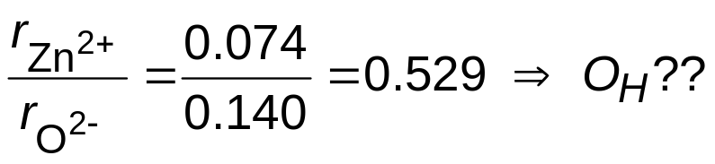
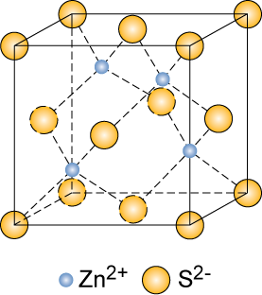
AX Crystal Structures
Zinc Blende structure
Size arguments predict Zn²⁺
in O_{H} sites,
In observed structure Zn²⁺
in T_{D} sites
Why is Zn²⁺ in T_{D} sites?
  bonding hybridization of zinc favors T_{D} sites
So each Zn²⁺ has 4 neighboring O²⁻
Ex: ZnO, ZnS, SiC

Slide 11
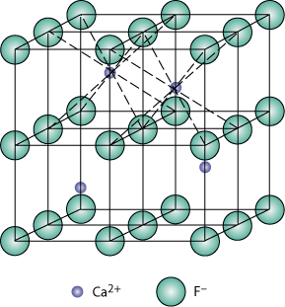
AX₂ Crystal Structures
Fluorite structure
Calcium Fluorite (CaF₂)
cations in cubic sites
UO_{2,} ThO₂, ZrO₂, CeO₂
antifluorite structure –
cations and anions
reversed

Slide 12
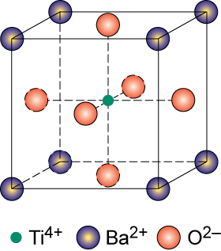
ABX₃ Crystal Structures
Perovskite
Ex: complex oxide
BaTiO₃

Slide 13
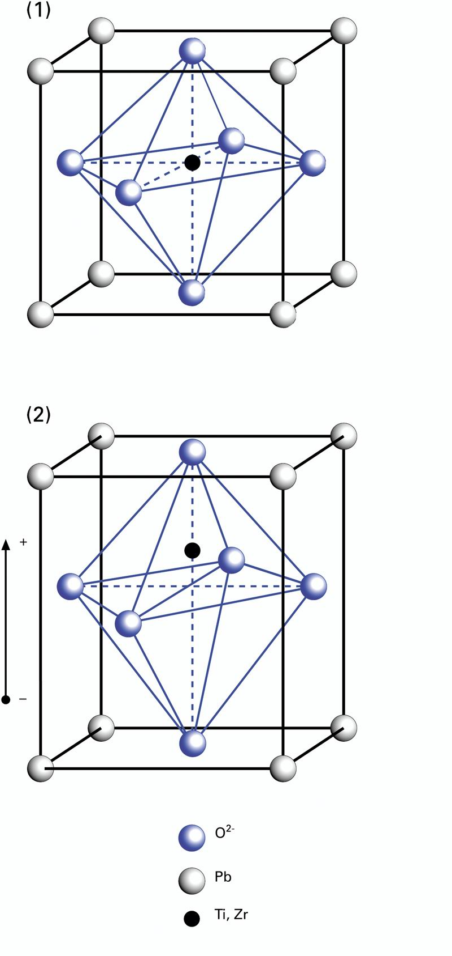
Barium Titanate is Piezoelectric
Generates an electric field if strained (sensor):
Phonograph needle
Strains in an electric field
(actuator):
AFM precision position controllers

Slide 14
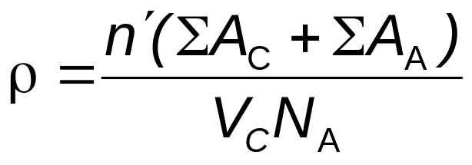
Ceramic Density Computation
Number of formula units/unit cell
    Volume of unit cell

Slide 15
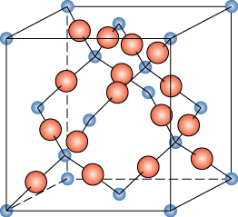
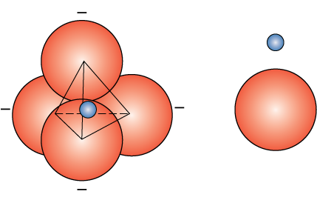
Silicate Ceramics
Most common elements on earth are Si & O
SiO₂ (silica) structures are quartz, crystobalite, & tridymite
The strong Si-O bond leads to a strong, high melting material (1710ºC)
Si⁴⁺
O²⁻
crystobalite
Notes:
Silicates make up most of the rock, etc.

Slide 16
Quartz
α: Trigonal symmetry; chiral; left and right handed versions exist
Transforms to β hexagonal at high temperatures (573 C)
Piezoelectric, used to make resonators for watches, sensors

Slide 17
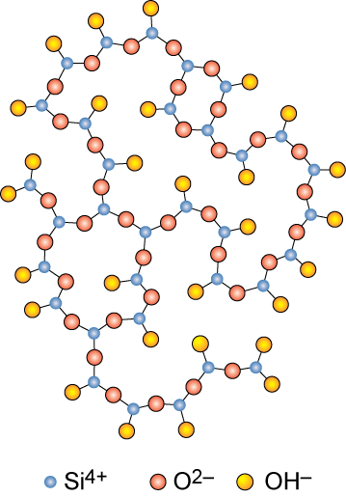
Amorphous Silica
Silica gels - amorphous SiO₂
  Si⁴⁺ and O²⁻ not in well-ordered lattice
  Charge balanced by H⁺ (to form
  OH⁻) at “dangling” bonds
    very high surface area > 200 m²/g
  SiO₂ is quite stable, therefore unreactive
    makes good catalyst support

Slide 18
Silica Glass
Dense form of amorphous silica
  Charge imbalance corrected with “counter cations” such as Na⁺
  Borosilicate glass is the pyrex glass used in labs
    better temperature stability & less brittle than sodium glass

Slide 19
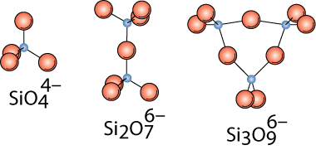

Silicates
  Combine SiO₄⁴⁻ tetrahedra by having them share corners, edges, or faces
  Cations such as Ca²⁺, Mg²⁺, & Al³⁺ act to neutralize & provide ionic bonding
Mg₂SiO₄
Ca₂MgSi₂O₇

Slide 20
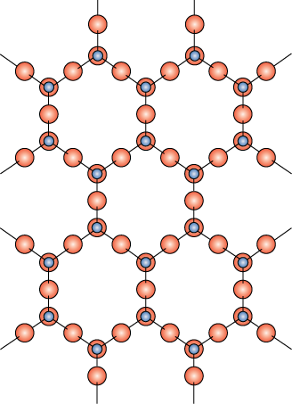

Layered Silicates
Layered silicates (clay silicates)
  SiO₄ tetrahedra connected together to form 2-D plane
(Si₂O₅)²⁻
So need cations to balance charge
=

Slide 21
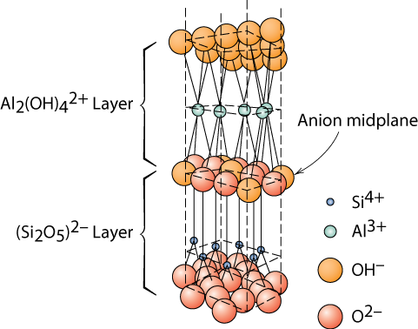
Layered Silicates
Kaolinite clay alternates (Si₂O₅)²⁻ layer with Al₂(OH)₄²⁺ layer
Note: these sheets loosely bound by van der Waal’s forces

Slide 22
Layered Silicates
Can change the counterions
  this changes layer spacing
  the layers also allow absorption of water
Micas KAl₃Si₃O₁₀(OH)₂
Bentonite
  used to seal wells
  packaged dry
  swells 2-3 fold in H₂O
  pump in to seal up well so no polluted ground water seeps in to contaminate the water supply.

Slide 23
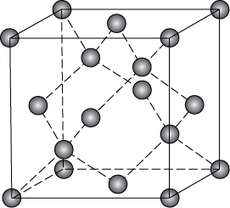
Carbon Forms
Carbon black – amorphous – surface area ca. 1000 m²/g
Diamond
  tetrahedral carbon: sp³
    hard – no good slip planes
    brittle – can cut it
  large diamonds – jewelry
  small diamonds
    often man made - used for cutting tools and polishing
  diamond films
    hard surface coat – tools, medical devices, etc.
Notes:
(C likes to have covalent bonds & tetravalent)

Slide 24
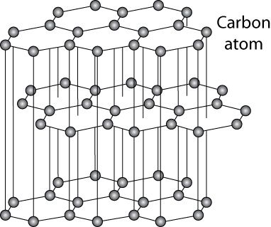
Carbon Forms - Graphite
layer structure – aromatic layers with sp² bonding
  weak van der Waal’s forces between layers
  planes slide easily, good lubricant
  single sheets: graphene
Notes:
Like connected benzene rings

Slide 25
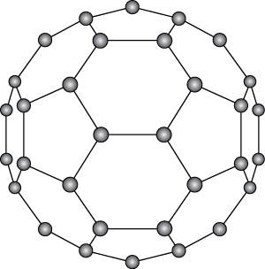
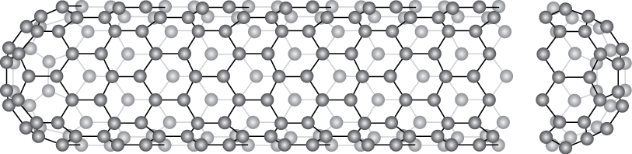
Carbon Forms –
Fullerenes and Nanotubes
Fullerenes or carbon nanotubes
  wrap the graphite sheet by curving into ball or tube
  Buckminister fullerenes
    Like a soccer ball C₆₀ - also C₇₀ + others

Slide 26
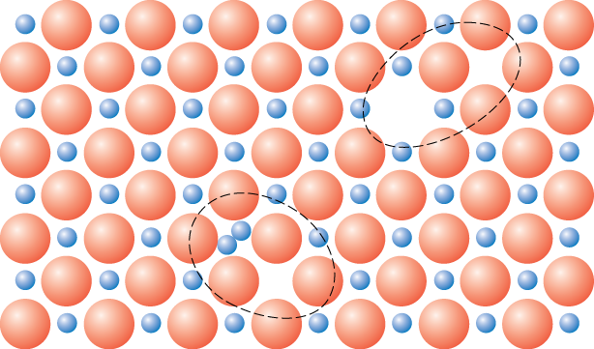
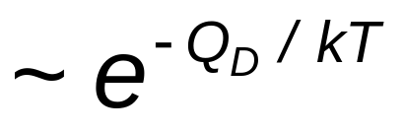
Defects in Ceramic Structures
• Frenkel Defect
--a cation is out of place.
• Shottky Defect
--a paired set of cation and anion vacancies.
Shottky
Defect:
Frenkel
Defect
• Equilibrium concentration of defects

Slide 27
Impurities
• Impurities must also satisfy charge balance = Electroneutrality
• Ex: NaCl
Na
+
Cl
-
cation
• Substitutional cation impurity
vacancy
Ca
2+
Na
+
Na
+
Ca
2+
initial geometry
Ca
2+
impurity
resulting geometry
• Substitutional anion impurity
an
ion vacancy
O
2-
Cl
-
Cl
-
initial geometry
O
2-
impurity
resulting geometry

Slide 28
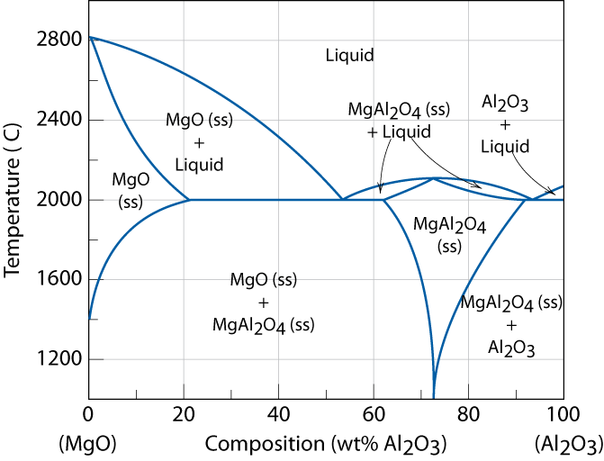
Ceramic Phase Diagrams
MgO-Al₂O₃ diagram:
°

Slide 29
Mechanical Properties
We know that ceramics are more brittle than metals. Why?
Consider method of deformation: dislocation-mediated slip on specific slip planes
    in ionic solids slip is very difficult
    too much energy needed to move one anion past another anion, or cation past cation
Covalent bonds also possible
  Bonds are strong
  Limited numbers of slip systems
  Complex dislocation structures

Slide 30
Measuring Elastic Modulus
• Room T behavior is usually elastic, with brittle failure.
• 3-Point Bend Testing often used.
--tensile tests are difficult for brittle materials.
F
cross section
L/2
L/2
d
R
b
δ = midpoint
rect.
circ.
deflection
• Determine elastic modulus according to:
F
3
3
F
L
F
L
x
E
=
=
F
δ
4
bd
3
δ
12
π
R
4
slope =
δ
rect.
circ.
δ
cross
cross
linear-elastic behavior
section
section

Slide 31
Measuring Strength
• 3-point bend test to measure room T strength.
F
cross section
L/2
L/2
d
R
b
δ = midpoint
rect.
circ.
deflection
location of max tension
• Flexural strength:
• Typ. values:
1.5F_{f} L
F_{f} L
Material
σ
fs
(MPa) E(GPa)
σ
=
=
Si nitride
Si carbide
Al oxide
glass (soda)
250-1000
100-820
275-700
69
304
345
393
69
fs
bd ²
πR³
F
rect.
F_{f}
x
δ
δ
fs

Slide 32
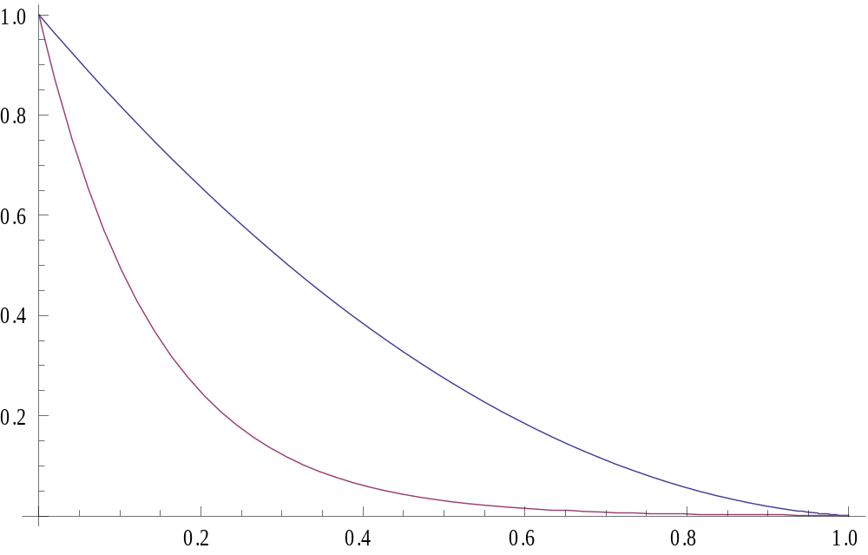
Porosity and Mechanical Properties
E=E₀(1-1.9 P+0.9 P²)
σ=σ₀ Exp(-n P)
σ/σ₀
E/E₀
Stiffness
Strength
Volume fraction porosity (P)

Slide 33
Summary
• Ceramic materials have covalent & ionic bonding.
• Structures are based on:
-- charge neutrality
-- maximizing # of nearest oppositely charged neighbors.
• Structures may be predicted based on:
-- ratio of the cation and anion radii
• Defects
-- must preserve charge neutrality
-- have a concentration that varies exponentially w/T.
• Room T mechanical response is elastic, but fracture
is brittle, with negligible deformation
• Elevated T creep properties are generally superior to
those of metals (and polymers)

Slide 34
Ceramic Crystal Structures
Oxide structures
  oxygen anions much larger than metal cations
  close packed oxygen in a lattice
  cations in the holes of the oxygen lattice

Slide 35
Site Selection
Which sites will cations occupy?
Size of sites
  does the cation fit in the site
Stoichiometry
  if all of one type of site is full the remainder have to go into other types of sites.
Bond Hybridization

Slide 36
Site Selection II
Stoichiometry
  If all of one type of site is full the remainder have to go into other types of sites.
Ex: FCC unit cell has 4 O_{H} and 8 T_{D} sites.
If for a specific ceramic each unit cell has 6 cations and the cations prefer O_{H} sites
4 in O_{H}
2 in T_{D}

Slide 37
Site Selection III
Bond Hybridization – significant covalent bonding
  the hybrid orbitals can have impact if significant covalent bond character present
  For example in SiC
    X_{Si} = 1.8 and X_{C} = 2.5
    ca. 89% covalent bonding
    both Si and C prefer sp³ hybridization
    Therefore in SiC get T_{D} sites

Slide 38
Measuring Elevated T Response
• Elevated Temperature Tensile Test (T > 0.4 Tm).
creep test
ε
σ
x
.
slope =
ε
ss
= steady-state creep rate
σ
time

